Slide 1
CSE 12: PA4
10-29-20
Focus: PA4, Runtime Analysis & Measurement

Slide 2
PA4 Overview
Tips!
Follow the format instructions very carefully on Gradescope!
Only 16/70 points are autograded, don’t rely on resubmission for this assignment
Two Parts
Part 1: Questions
Big-O Justification
Analysis of ArrayStringList and LinkedStringList
6 Mystery Functions: Determe big-Θ, measure implementations (in part 2) and match
Part 2: Code
Write a program to measure the mystery methods
Matches the methods to the source given
Generate graphs to justify

Slide 3
Categorizing Runtimes

Slide 4
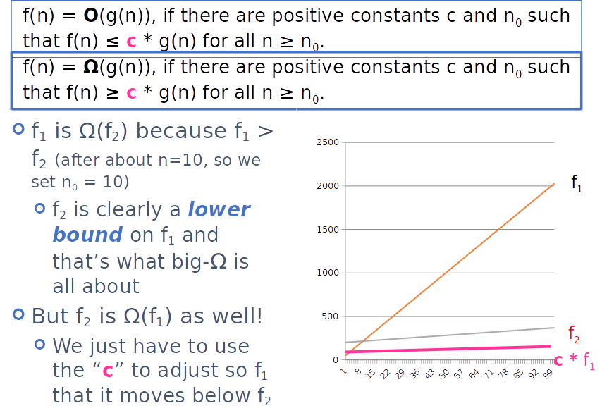

Slide 5
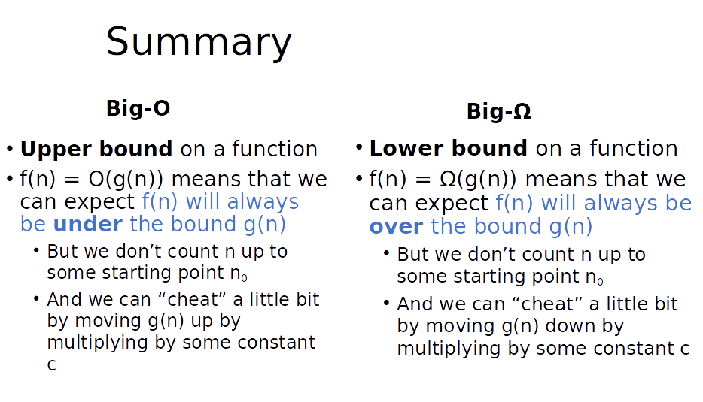

Slide 6
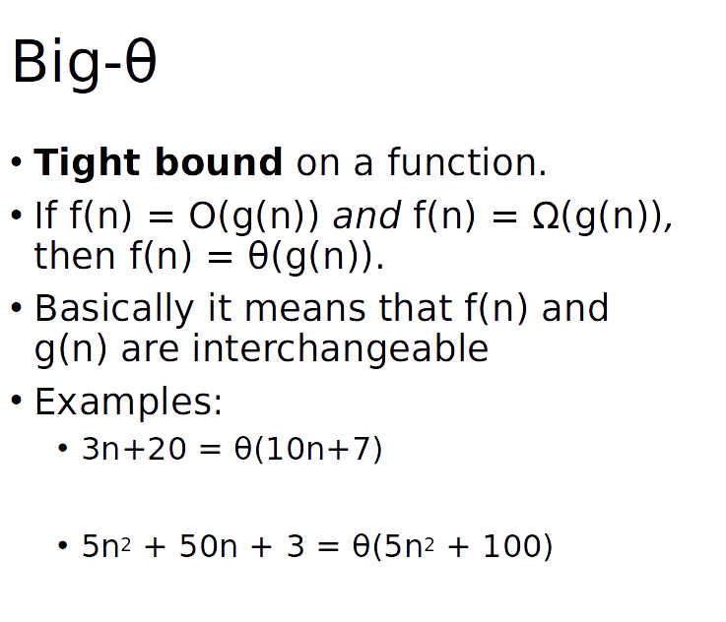

Slide 7
How to measure runtime in Java
Remember to do two things to ensure your measurements are as accurate as possible:
Turn off Java compiler optimizations
Call each method once (dummy call) before calling them to measure their runtimes; the timing of the first call can be noisy and inaccurate
How to turn off optimization in Eclipse (from the write up; scroll to last page):
https://docs.google.com/document/d/1vwckO76TrBT8B5E4xQ2-v2OXncLa6SQWuaQkNZaCPB0/edit
How to turn off optimization in terminal
add in the flag in your javac and java commands. Examples: java -Djava.compiler=NONE myClass
Example code from discussion on how to calculate runtime of a method using System.nanoTime() will be posted on the course Github

Slide 8
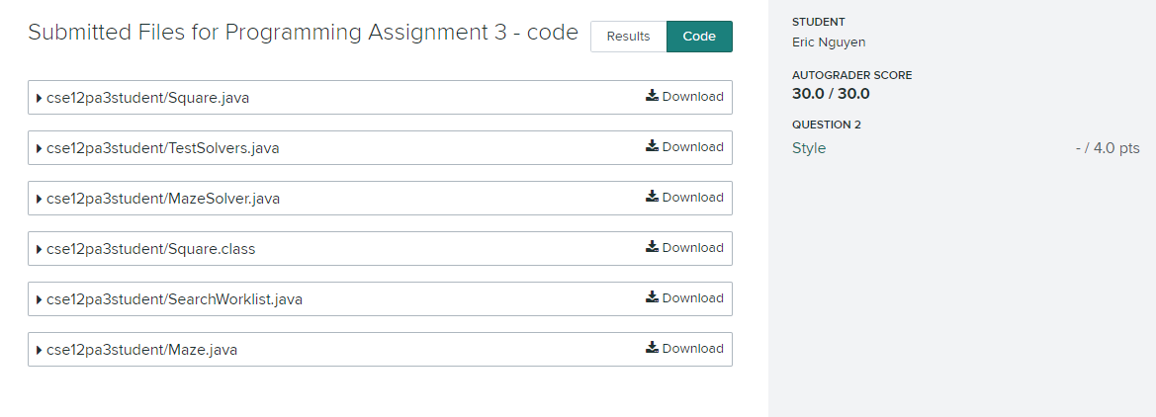
Verifying submitted file paths
1.
2.

Slide 9
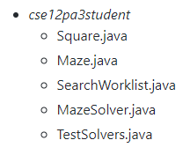
Verifying submitted file paths
1.
2.
Directly from writeup!

